Slide 1
Digital Portfolio
STUDENT NAME: Dilli babu.A
REGISTER NO AND NMID: asunm11124033004
DEPARTMENT: BCA
COLLEGE: L.N.Government college/ Madras University

Slide 2
PROJECT TITLE
Design and development of a personal portfolio website

Slide 3

PROBLEM STATEMENT
The main problem identified was the lack of a centralized, visually appealing, and professional way to showcase skills, projects, and achievements. Many individuals rely on scattered documents, outdated resumes, or plain text profiles that fail to capture attention.

Slide 4


AGENDA
Problem Statement
Project Overview
End Users
Tools and Technologies
Portfolio design and Layout
Features and Functionality
Results and Screenshots
Conclusion
Github Link
3/21/2024 Annual Review

Slide 5

PROJECT OVERVIEW
This project focuses on designing and developing a personal portfolio website that highlights technical skills, creative abilities, and professional achievements in an interactive and user-friendly manner. The portfolio aims to serve as both a personal brand identity and a digital resume.

Slide 6

WHO ARE THE END USERS?
The primary users are recruiters, hiring managers, clients, and collaborators who wish to evaluate the professional background of the portfolio owner. Secondary users include peers, educators, and general audiences interested in exploring creative and technical work

Slide 7

TOOLS AND TECHNIQUES
The portfolio is built using HTML, CSS, and JavaScript for structure, styling, and interactivity. Frameworks like React.js or Bootstrap may be used for responsive design. For backend integration and contact forms, technologies such as Node.js, Firebase, or PHP are implemented. Version control is managed via GitHub.

Slide 8
POTFOLIO DESIGN AND LAYOUT
The layout follows a modern, minimal, and responsive design. Sections include Home, About, Skills, Projects, Resume, and Contact. The interface uses a clean grid system, consistent color scheme, smooth transitions, and mobile-friendly responsiveness to ensure a professional look.
8

Slide 9
FEATURES AND FUNCTIONALITY
Interactive navigation bar
Dynamic project showcase with images and descriptions
Downloadable resume section
Contact form with email integration
Light/Dark mode toggle
Responsive design for all devices
Social media integration

Slide 10
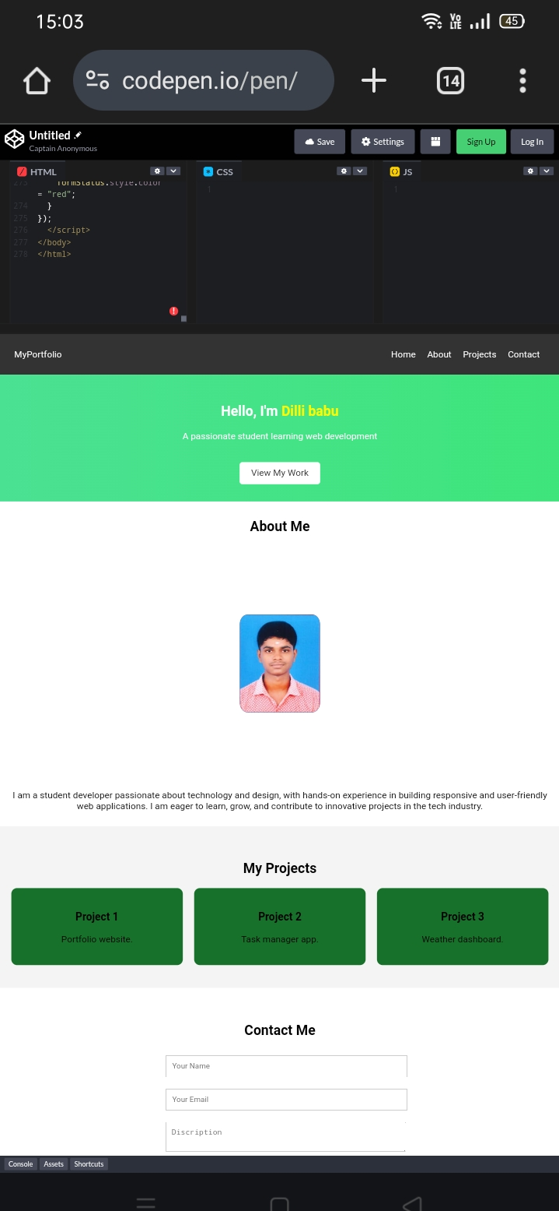

RESULTS AND SCREENSHOTS
3/21/2024 Annual Review
10

Slide 11
The final portfolio demonstrates a professional, engaging, and visually appealing design. It effectively highlights key skills, showcases completed projects with screenshots, and provides an easy way for users to get in touch. Screenshots of the landing page, projects section, and contact form illustrate the polished output.
RESULTS AND SCREENSHOTS (cont.)

Slide 12
CONCLUSION
The portfolio project successfully bridges the gap between technical expertise and visual presentation. It provides end users with a clear, interactive, and memorable way to evaluate skills and projects. Overall, it enhances personal branding, increases visibility to recruiters and clients, and serves as a strong digital identity.
12

Slide 13
Github Link
https://dillibabu2007.github.io/portfolio-1/

